Slide 1



DROID SCANNER :
AN APP SECURITY MANAGEMENT SYSTEM
Supervised By
Prof. Md. Zulfiquar Hafizz
Presented by:
Salsabila Zaman 1443
Md. Shaikhul Islam 1438

Slide 2



INTRODUCTION TO
DROID SCANNER
The Droid Scanner : App Security Management System enhances security by providing tools to safeguard sensitive data. This presentation will explore its features and implementation strategies to ensure robust protection against mobile threats.

Slide 3

MOTIVATION
1. User Security
2. Developer Support
3. Threat Mitigation
4. Data Privacy
5. Industry Compliance
6. Enhanced Trust
7. Accessibility
8. Educational Purpose
9. Prevention of Financial Loss
10. Continuous Improvement
Notes:
Mobile devices have become an essential part of modern life, offering convenience, connectivity, and functionality that impact almost every aspect of our daily routines. In this regard we use a variety of apps. They enable instant communication through calls, messages, and video chats, while providing quick access to information, news, and educational resources. With apps for productivity, health tracking, entertainment, and social media, mobile devices help us stay organized, informed, and connected. They simplify tasks like shopping, payments, and navigation, making life more efficient and secure. From staying in touch with loved ones to managing work and personal goals, mobile devices and apps have revolutionized the way we live, work, and interact, becoming indispensable tools in today’s fast-paced world. Along with the convenience of using device apps, there may occur some unexpected inconveniences that make our life horrible. Among them, the effect of malicious apps or malware is very pathetic. That’s why we tend to develop this app. Other than this,

Slide 4

SRS Document
Report on the Project: DROID SCANNER

Slide 5
Features Checklist : Done
Malicious App Detection
APK Extraction
Permission & Intent Viewer
Model Training
Analyse permissions and intents, storing them in a database.
Model Training
Multiple Scan Options: Quick scan.

Slide 6
Features Checklist : Remaining
Custom App Management: Whitelist - Blacklist
User-Dedicated Database
User Dashboard
Update the database with new data.
Multiple Scan Options: Full scan.

Slide 7
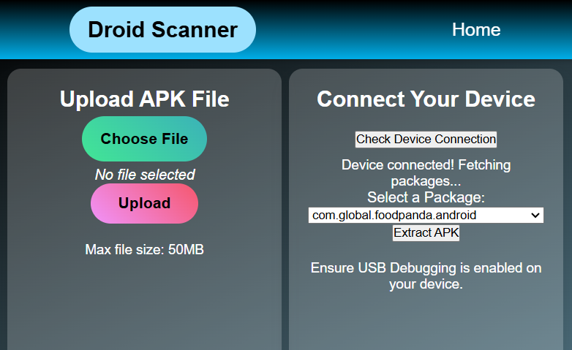
Input Prompt:

Slide 8

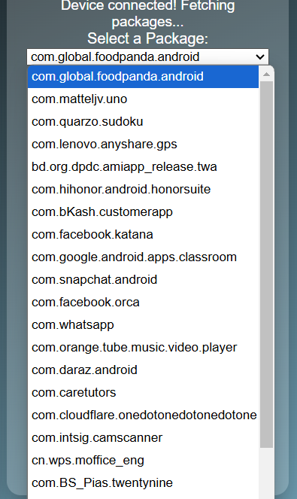
Apk Package list on the Device:

Slide 9
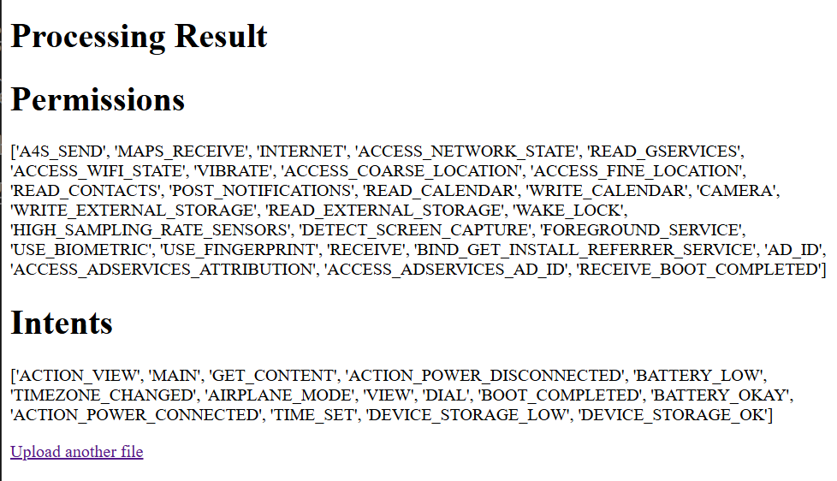
Feature Output:

Slide 10

Remaining Tasks:
Database Integration
Frontend Completion
App Testing
Deployment

Slide 11
Development Update
GitHub Link: SPL-2: ’Droid Scanner’

Slide 12

Thanks For your
Kind Patience..
Any Question ?

